Slide 1
Debugging Session with main features
Training Session

Slide 2
Open and Save Test in local machine
Open Test – Load Test
ST\app\VTD\Framework\DesignerFramework\app\DesignerModel\ServiceTestFactory.cs
public IServiceTest Load(ShellTest shellTest)
Load test data from test.db TestPersistence.LoadTest(db, internalTest);
Save Test
..\..\ServiceTestFactory.cs : SaveTest(…)
ST\app\VTD\Framework\DesignerFramework\app\DesignerModel\Test.cs
public virtual void Save()
Save test to its own database: TestPersistence.SaveTest(db, this);
Save as Test
ServiceTestProject.cs → SaveAs(….)

Slide 3
Open and Save Test from/to ALM
Open Test from ALM
ST\app\VTD\Framework\DesignerFramework\app\ShellServices\StProjectService.cs
public static string DownloadAlmTest(string vpath)
Download all Test resources and store in local folder TD_80
ST\app\VTD\Framework\DesignerFramework\app\ExtendedRepository\AlmRepository\AlmStorage.cs
public override string Download(string remotePath)
Save/SaveAs to ALM
StProjectService.cs → SaveAs()
AlmStorage.cs -- > SaveAsAlmItem(…)

Slide 4
How to debug RT script
Open CS project of the test in VS
Open Properties -> Debug tab -> Start external program
Enter: C:\Program Files (x86)\HP\Unified Functional Testing\bin\HP.ST.Fwk.InternalExecuter.exe
Command line argument: -test "<test-folder>“
Add class we need to debug and place breakpoint

Slide 5
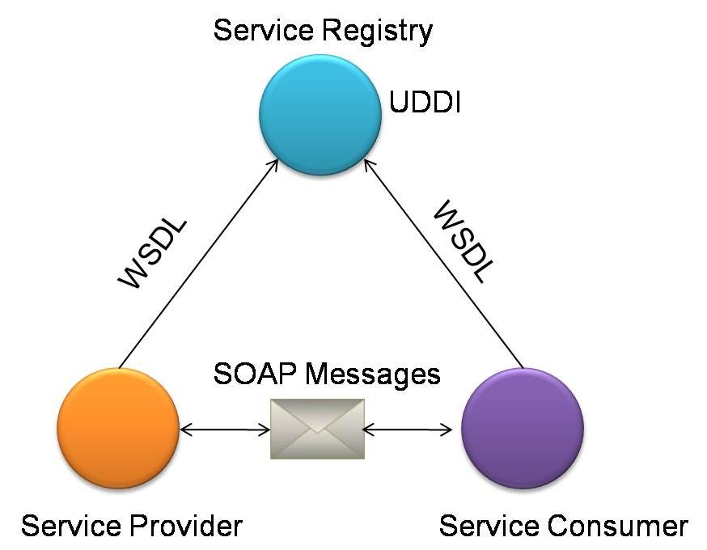
Web-Service - General
XML: format the data
SOAP: transfer the data
WSDL: describing the services available
UDDI: listing what services are available
Notes:
Web Services is a mechanism to provide a standard means of communication between various applications operating on similar or heterogeneous platforms. The World Wide Web Consortium (W3C) is the official body for maintaining web services standards. In the context of Service Oriented Architecture, Web Services are used to facilitate communication between service providers and service consumers. Special adapters are used for applications that don’t support web services. Krawler employs web services standards that enable our Service Oriented Architecture to offer functionalities such as location neutrality and technology/platform independence. There are many web services standards used in the SOA framework, including WS-Security, WS-Transaction, WS-Reliable Messaging and WS-Policy. But the underlying principals of web services are publication, discovery and communication: Publish – Service Producers register their service in the SOA registry. Web Services Description Language (WSDL) is used to describe a service. Discovery – Service Consumers make a request for a service in the SOA registry. Universal Description, Discovery and Integration (UDDI) standard is used for locating a service in the registry. Communication – Simple Object Access Protocol (SOAP) is used for facilitating communication between Service Providers and Consumers.

Slide 6
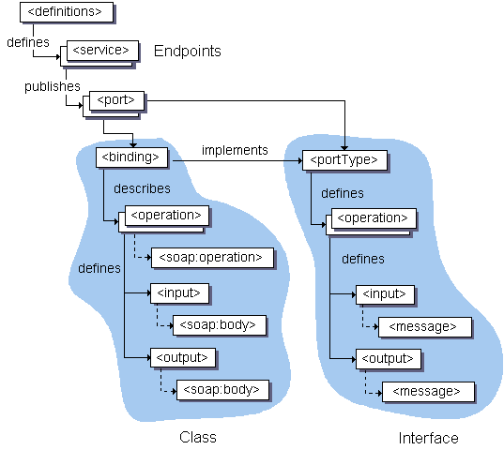
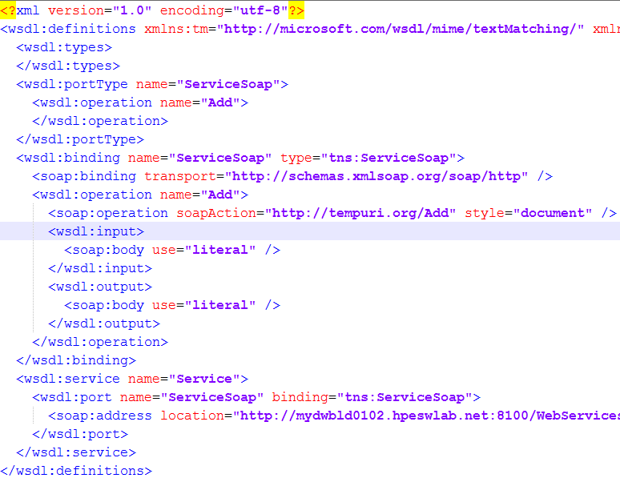
WS - WSDL structure
WSDL Structure
WSDL file

Slide 7
Import WSDL
Import mechanism structure
ST\app\VTD\Extensibility\TechnologyImplementationExtensibility\app\WebServicesTechnologyDesignTime\WebServiceImporter.cs
ST\app\VTD\Utils\Shared\app\WsdlImporter\Implementation\Importer\NetworkImporter.cs
ST\app\VTD\Utils\Shared\app\WsdlImporter\Implementation\Importer\CustomImporter.cs
ST\app\VTD\Utils\Shared\app\WsdlImporter\Implementation\Importer\FuzzyImporter.cs
WSDL importers’ types
Default
Fuzzy (if schemas have errors, use Fuzzy mode to try to fix them)
Debug

Slide 8
WS Security

